Slide 1
Scene Parsing

Slide 2
Parametric
Small advantage in accuracy
Nonparametric
Large-scale dynamic datasets
Fast

Slide 3
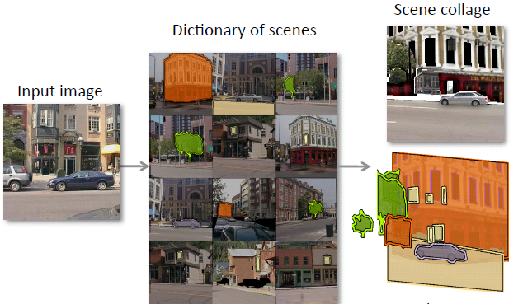
Object class
Background
Sea, sky
Large region
Object
Person, car
Ordinal depth
Scene collaging [IL13]
Exemplar SVM [TL13]
Rare classes
Enrich retrieved set [YPCY14]
Superpixels tend to fragment objects
Content-adaptive windows (objectness measuring) [TL14]
P. Isola and C. Liu. Scene collaging: analysis and Synthesis of natural images with semantic layers. In ICCV, 2013
J. Tighe and S. Lazebnik. Finding things: Image parsing with regions and per-exemplar detectors. In CVPR, 2013.
J. Yang, B. Price, S. Cohen and M.Yang. Context driven scene parsing with attention to rare classes. In CVPR, 2014.
F. Tung and J. J. Little. CollageParsing: Nonparametric scene parsing by adaptive overlapping windows. In ECCV, 2014.

Slide 4
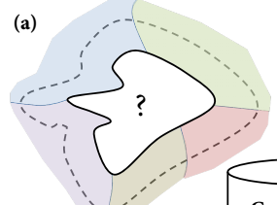
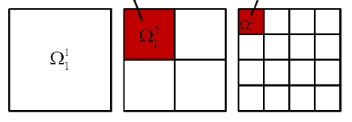
Semantic Context
Context information
Co-occurrence statistics of labels
Local context [4]
Superpixel neighborhoods
Global context [20]
Three layer spatial pyramid
[4] D. Eigen and R. Fergus. Nonparametric image parsing using adaptive neighbor sets. In CVPR, 2012.
[20] G. Singh and J. Kosecka. Nonparametric scene parsing with adaptive feature relevance and semantic context. In CVPR, 2013.

Slide 5
Dataset
SIFT Flow
2688 images
33 classes
LMSun
50176 images
232 classes

Slide 6
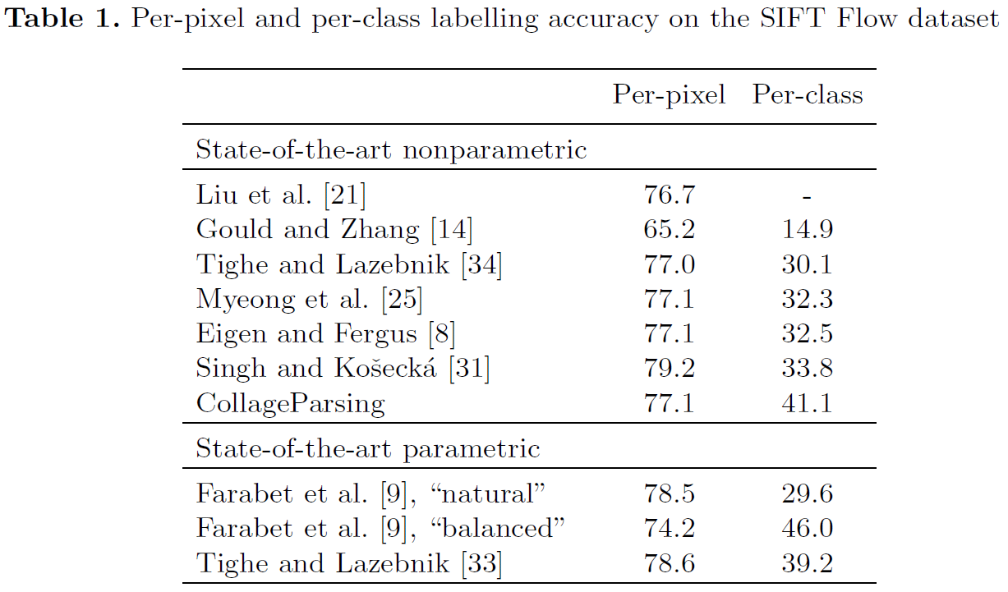
Experiments
[TL14] Sift Flow dataset
[TL14]
[YPCY14] (non-para) 79.8 48.7
J. Yang, B. Price, S. Cohen and M.Yang. Context driven scene parsing with attention to rare classes. In CVPR, 2014.
F. Tung and J. J. Little. CollageParsing: Nonparametric scene parsing by adaptive overlapping windows. In ECCV, 2014.
[33] J. Tighe and S. Lazebnik. Finding things: Image parsing with regions and per-exemplar detectors. In CVPR, 2013.

Slide 7
Nonparametric algorithm
Image retrieval
Retrieve similar image
Image segmentation
Superpixels
Content-adaptive windows [TL14]
Label transfer
MRF model
F. Tung and J. J. Little. CollageParsing: Nonparametric scene parsing by adaptive overlapping windows. In ECCV, 2014

Slide 8
Image Retrieval
Retrieve similar image
Caffe CNN feature (Layer 7)
Euclidean distance

Slide 9
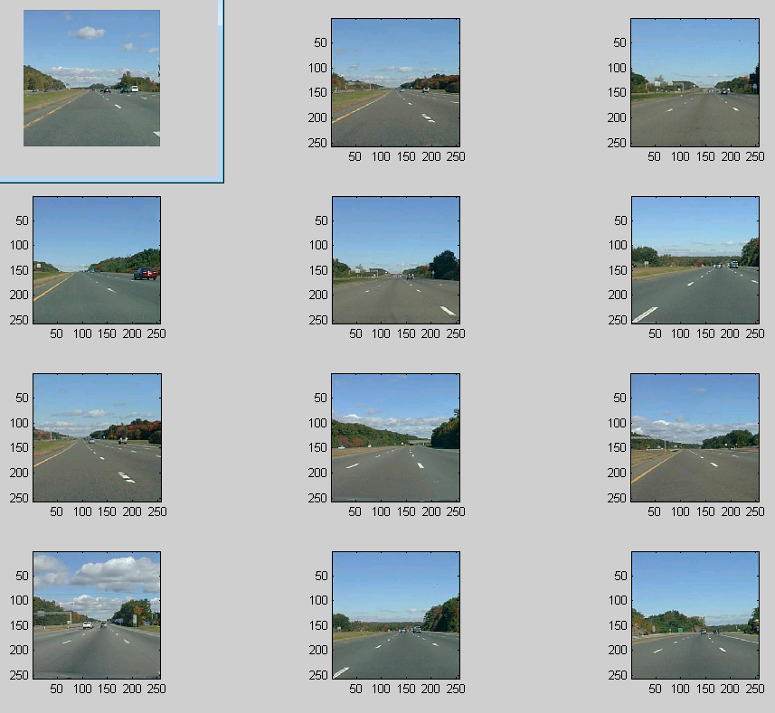

Slide 10
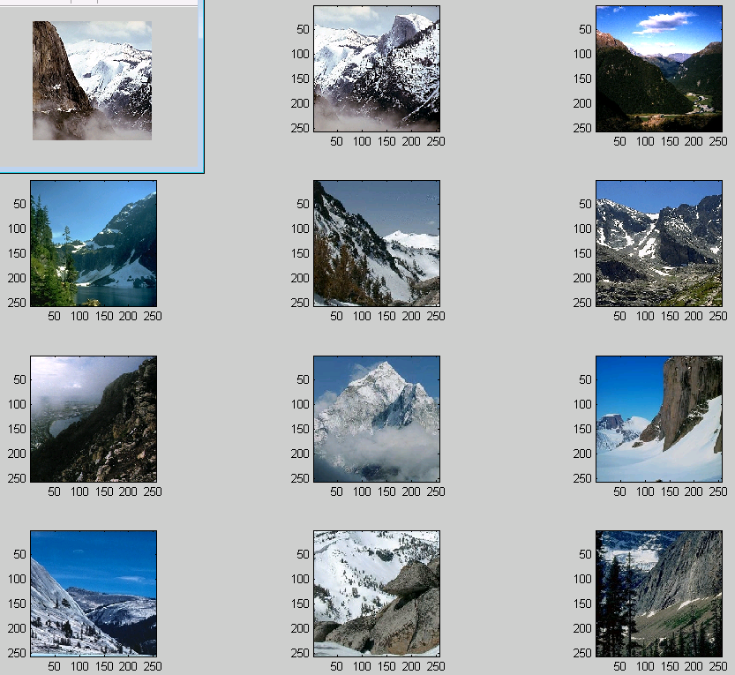

Slide 11
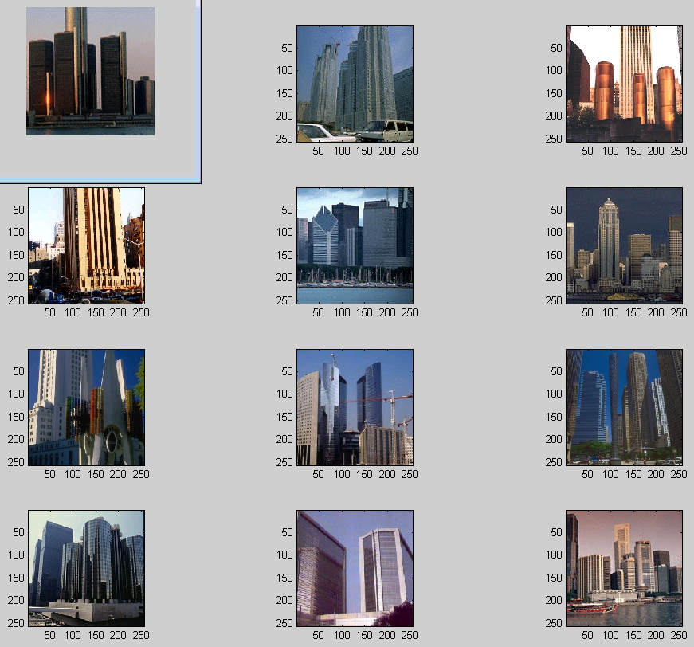

Slide 12
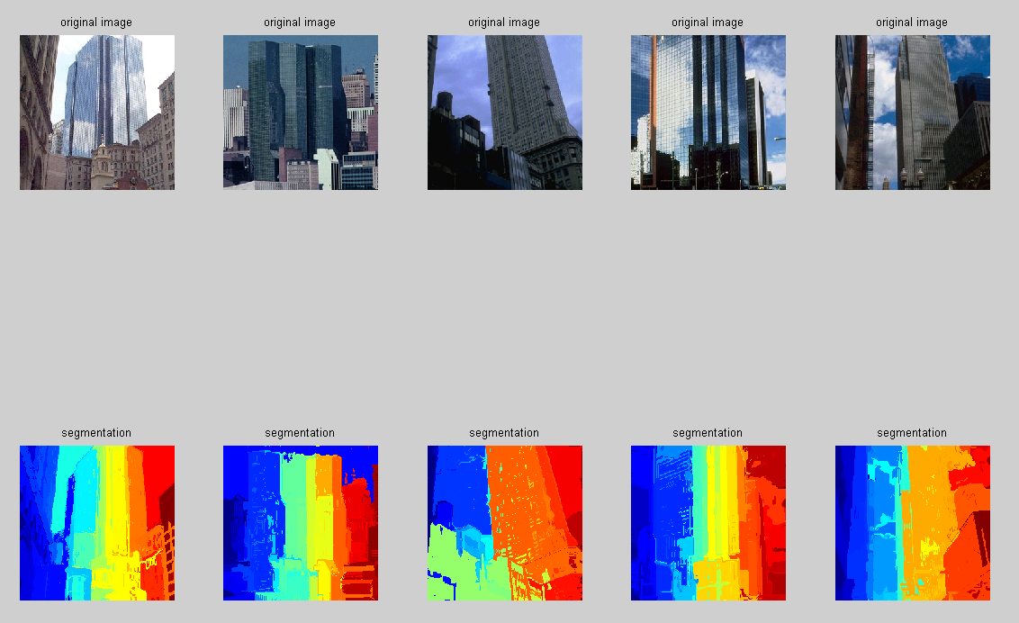
Segmentation

Slide 13
Conclusion
Nonparametric algorithm
“Object” in the image
Objectness measure
Semantic Context
Rare class expansion

